Slide 1
Heart Disease Prediction System
Submitted by:
Satyam Singh 21bcs11016
Kartik Kaushik 21BCS3713
Nikhil Sharma 21BCS6325
Aryan Chaudhary 21bcs11060

Slide 2
Table of Contents:
Introduction
Problem Statement
Data Collection
Technology Used
Data Cleaning
Library Used

Slide 3
Introduction
Heart disease predictor is an offline platform designed and developed to explore the path of machine learning . The goal is to predict the health of a patient from collective data, so as to be able to detect configurations at risk for the patient, and therefore, in cases requiring emergency medical assistance , alert the appropriate medical staff of the situation of the latter.
We initially have a dataset collecting information of many patients with which we are able to conclude the results into a complete form and can predict data precisely. The results of the predictions, derived from the predictive models generated by machine learning, will be presented through several distinct graphical interfaces according to the datasets considered. We will then bring criticism as to the scope of our results.

Slide 4
Problem Statement
Machine learning allows building models to quickly analyze data and deliver results, leveraging the historical and real-time data, with machine learning that will help healthcare service providers to make better decisions on patient’s disease diagnosis .
By analyzing the data we can predict the occurrence of the disease in our project. This intelligent system for disease prediction plays a major role in controlling the disease and maintaining the good health status of people by predicting accurate disease risk .
Machine learning algorithms can also be helpful in providing vital statistics, real-time data and advanced analytics in terms of the patient’s disease, lab test results, blood pressure, family history, clinical trial data , etc. to doctors.

Slide 5
Data Collection
Data has been collected from Kaggle .
Data Collection is the process of gathering and measuring information from countless different sources. In order to use the data we collect to develop practical artificial intelligence(AI) and machine learning solutions, it must be collected and stored in a way that makes sense for the business problem at hand,
What is Kaggle ?
KAGGLE is an online community of data scientists and machine learners , owned by Google LLC. Kaggle allows users to find and publish data sets , explore and build models in a web-based data-science environment, work with other data scientists and machine learning engineers, and enter competitions to solve data science challenges.

Slide 6
Attributes Used
Age
Sex
Chest Pain (CP)
Blood Pressure (Trestbps)
Cholesterol (Chol)
Fasting Blood Sugar (fbs)
Heart Rate (Thalach)
Resting Electrocardiographic Results (Restecg)
Exercise Induced Angina (Exang)
Depression (oldpeak)
Slope
Major Vessels (Ca)

Slide 7
Testing Technologies
Anaconda (Python)- Anaconda is a free and open source distribution of the Python and R programming languages for scientific computing, that aims to simplify package management and deployment.
Jupyter Notebook- The Jupyter Notebooj is an open source web application that allows you to create and share documents that contain live codes, equations, visualization and narrative text. Uses include: data cleaning and transformation, numerical simulations, statistical modeling, data visualization, machine learning and much more.

Slide 8
Data Cleaning
Data Cleaning is essentially the task of removing errors and anomalies or replacing observed values with the true values from data to get more values In analytics.
Methods:
Get Rid of extra spaces
Select and treat all blank cells
Convert numbers stored as text into numbers
Remove Duplicates
Highlight Errors
Change Text to lower/Upper/Proper Case
Spell Check
Delete all formatting

Slide 9
Libraries Used
Pandas- is a software library written for the Python programming language for data manipulation and analysis. In particular, It offers data structures and operations for manipulating numerical tables and time series pandas is a Python package providing fast, flexible and expressive data structures designed to make working with “relational” or “labeled” data both easy and intuitive. It aims to be fundamental high-level building block for doing practical, real world data analysis in Python.
Numpy- is a library for the Python programming language, adding support for large, multi-dimensional arrays and matrices, along with a large collection of high-level mathematical functions to operate on these arrays.

Slide 10
OUTPUTS

Slide 11
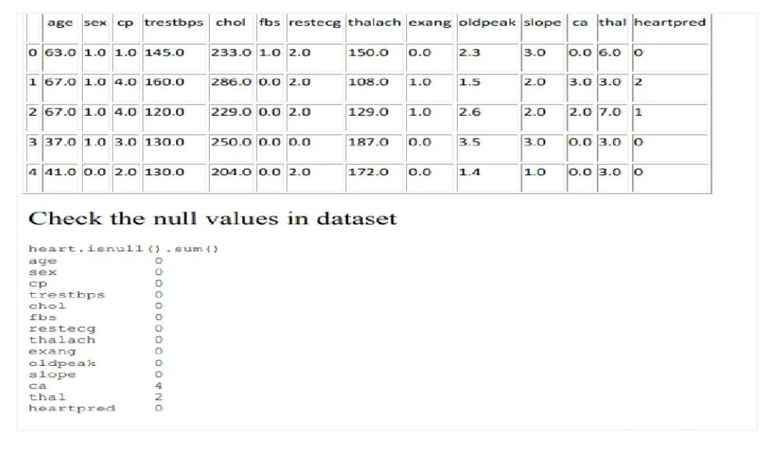

Slide 12
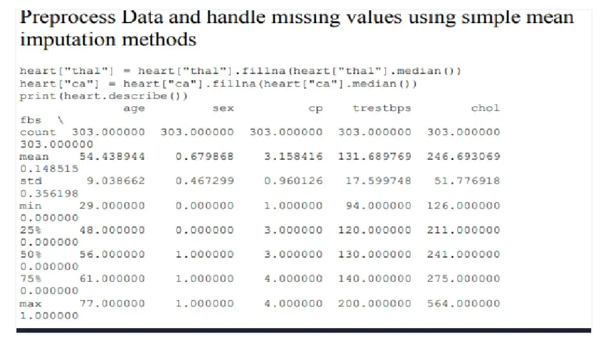

Slide 13
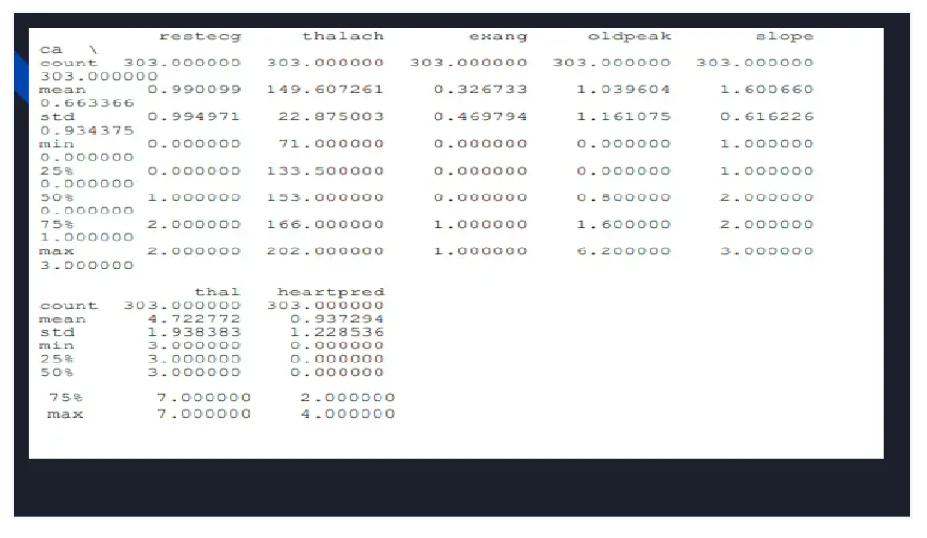

Slide 14
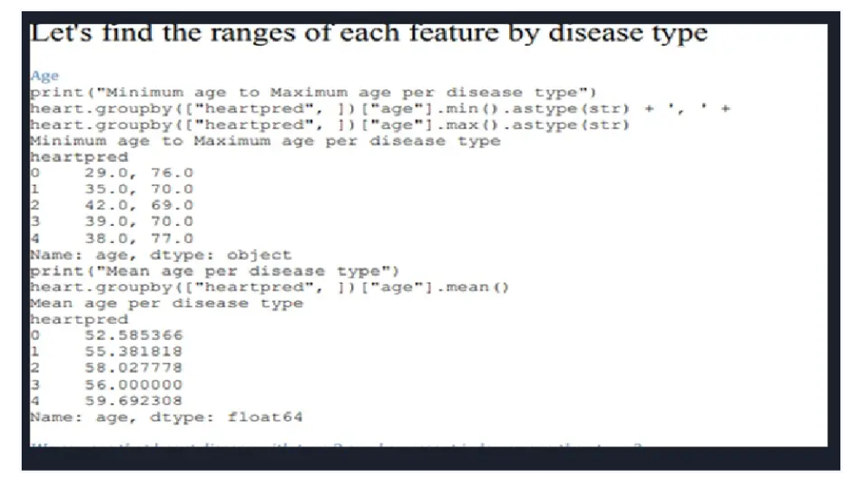

Slide 15
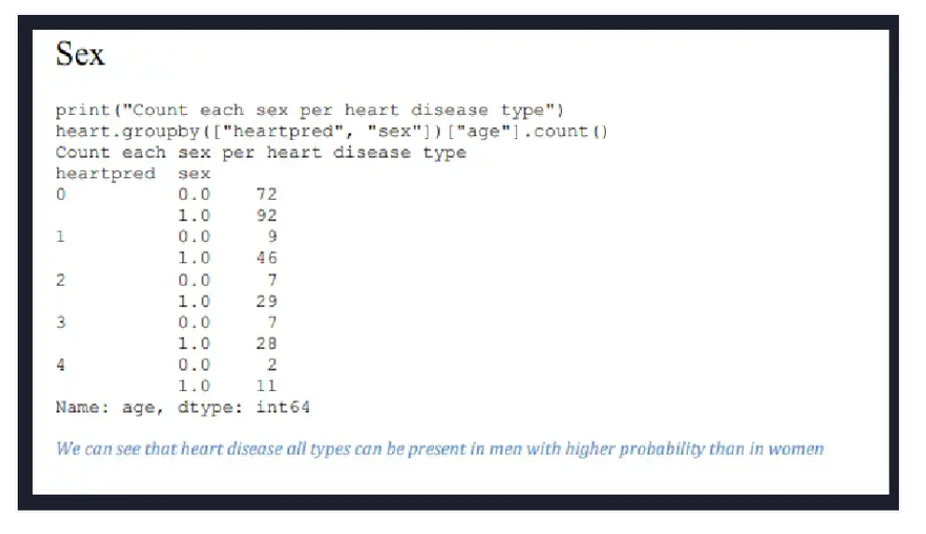

Slide 16
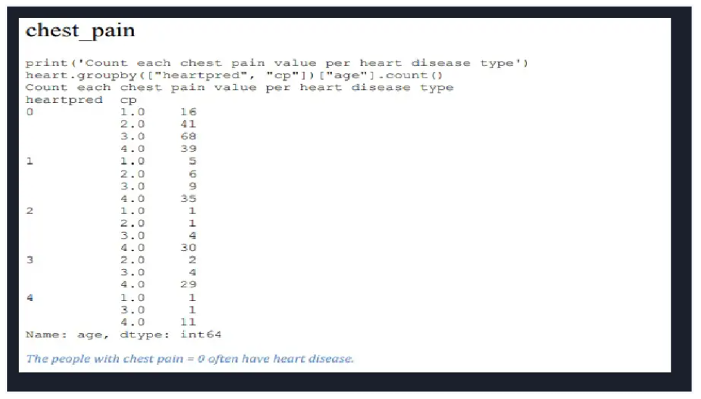

Slide 17
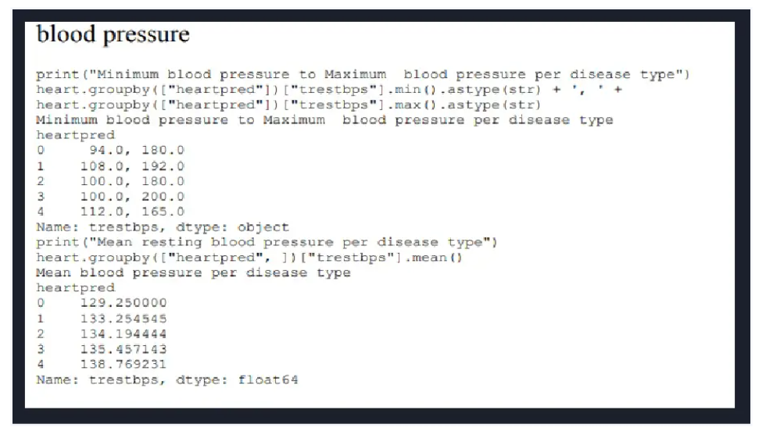

Slide 18
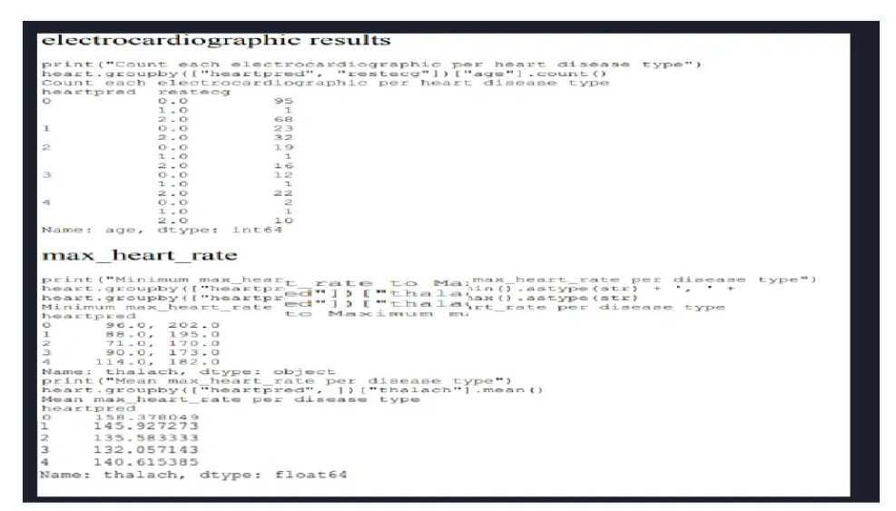

Slide 19
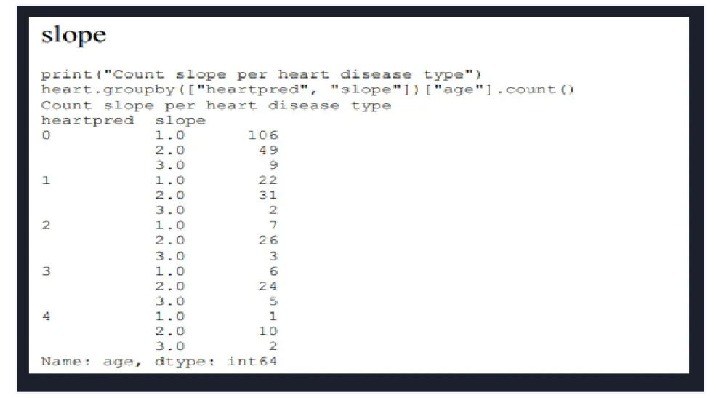

Slide 20
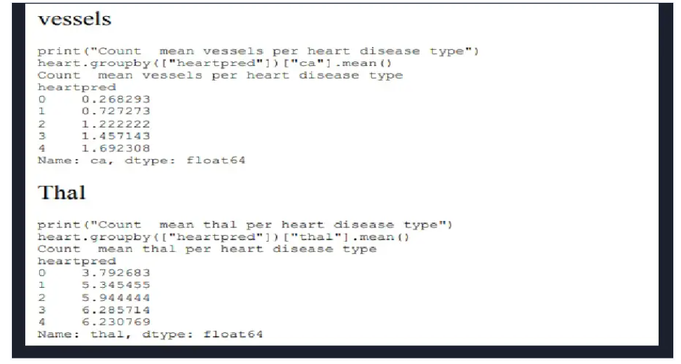

Slide 21
